Slide 1

Introductory Statistics
Introductory Statistics

Slide 2
Describing Bivariate Data: Scatterplots, Correlation, and Covariance
Scatterplot
Correlation Coefficient
Form, Direction and Strength
Covariance
Effect of Outliers
Non-Linear Relationships

Slide 3
Scatterplot or Scatter Diagram
A Scatterplot or Scatter Diagram displays the relationship between two quantitative variables that are measured on the same individuals. Mark the values of one variable on the horizontal axis (x axis) and values of the other variable on the vertical axis (y axis). Plot each individual data as a point on the graph.

Slide 4
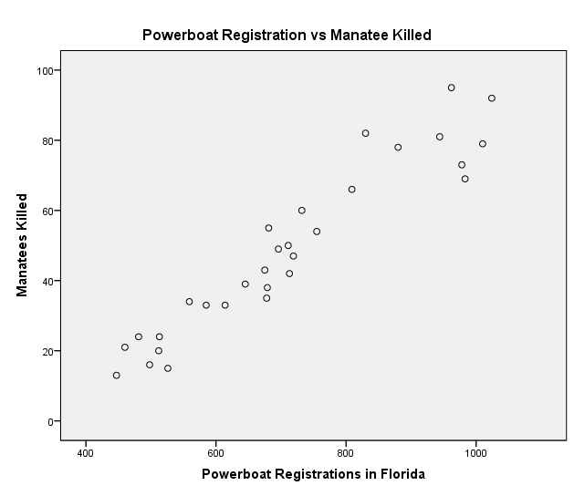
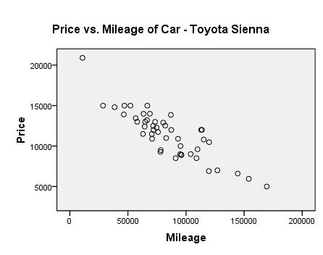
Scatterplot or Scatter Diagram
Direction – Positive
Direction – Negative

Slide 5
Describing Bivariate Data: Scatterplots, Correlation, and Covariance
Scatterplot
Correlation Coefficient
Form, Direction and Strength
Covariance
Effect of Outliers
Non-Linear Relationships

Slide 6
Correlation r
Correlation r - Calculation to determine Strength and Direction of a linear relationship between two quantitative variables
  Correlation r is always a number between -1 and 1
  positive values of r imply a positive linear relationship between the two variables
  negative values of r imply a negative linear relationship between the two variables
  values of r close to zero suggest there is a weak correlation between the two variables
  if r is close to 1, it is evidence of a strong positive linear relationship between the two variables
  if r is close to −1, there is evident of a strong negative linear relationship between the two variables
  if r equals 1 or −1, then there is a perfect linear relationship between the two variables (the points are all in a line)
  the correlation of X and Y is the same as the correlation between Y and X (i.e. there is no distinction between explanatory and response variables.)
Correlation is not resistant, so outliers can greatly change the value of r. Examine the outliers and determine their influence on the relationship between x and y
The correlation coefficient, r, is a sample statistic. It is an estimate of the population correlation coefficient, which we will denote as ρ. Usually, we do not know ρ.

Slide 7
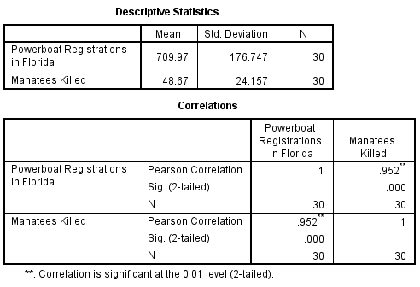
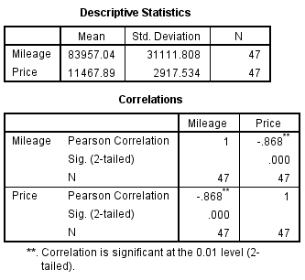
Correlation r

Slide 8
Describing Bivariate Data: Scatterplots, Correlation, and Covariance
Scatterplot
Correlation Coefficient
Form, Direction and Strength
Covariance
Effect of Outliers
Non-Linear Relationships

Slide 9
Form, Direction and Strength
Examining Scatterplot and Correlation – Three Items to look for in the overall Pattern:
  Form – Linear relationships, where the points show a straight-line pattern, are an important form of relationship between two variables. Curved relationship is another form to watch for.
  Direction – If the relationship has a clear direction, we speak of either positive association or negative association
  Strength – is determined by how close the points in the scatterplot line
Also, look for outliers or other deviations from this pattern.

Slide 10
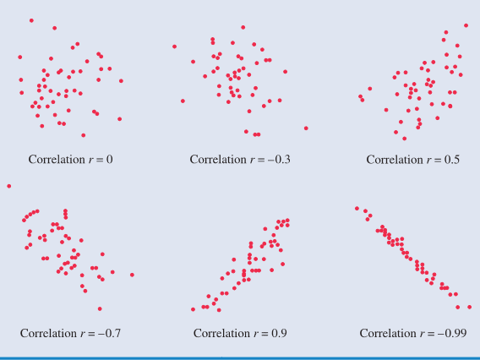
Form, Direction and Strength (Examples)
Form – Linear or Non Linear
Direction – Positive or Negative
Strength – Weak or Strong

Slide 11
Form, Direction and Strength (Example)
Correlation r = -0.868
Correlation r = 0.952
Form – Linear
Direction – Positive
Strength – Strong
Form – Linear
Direction – Negative
Strength – Strong

Slide 12
Describing Bivariate Data: Scatterplots, Correlation, and Covariance
Scatterplot
Correlation Coefficient
Form, Direction and Strength
Covariance
Effect of Outliers
Non-Linear Relationships

Slide 13

Covariance
Covariance $s_{xy}=r∗s_{x}∗s_{y}$
$s_{xy}=0.952∗176.75∗24.16=4,064.73$
$s_{xy}=−0.868∗31111.81∗2917.53=−78,788,149.63$

Slide 14
Describing Bivariate Data: Scatterplots, Correlation, and Covariance
Scatterplot
Correlation Coefficient
Form, Direction and Strength
Covariance
Effect of Outliers
Non-Linear Relationships

Slide 15
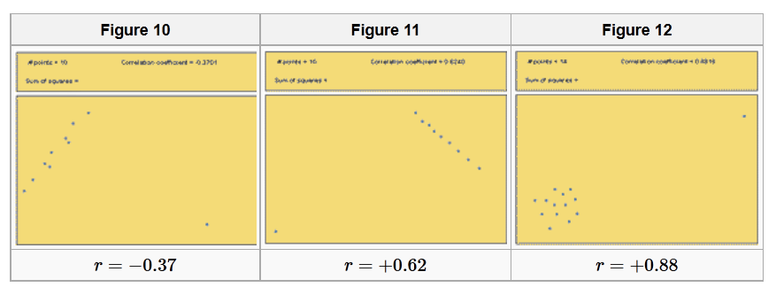
Effects of Outliers

Slide 16
Describing Bivariate Data: Scatterplots, Correlation, and Covariance
Scatterplot
Correlation Coefficient
Form, Direction and Strength
Covariance
Effect of Outliers
Non-Linear Relationships

Slide 17
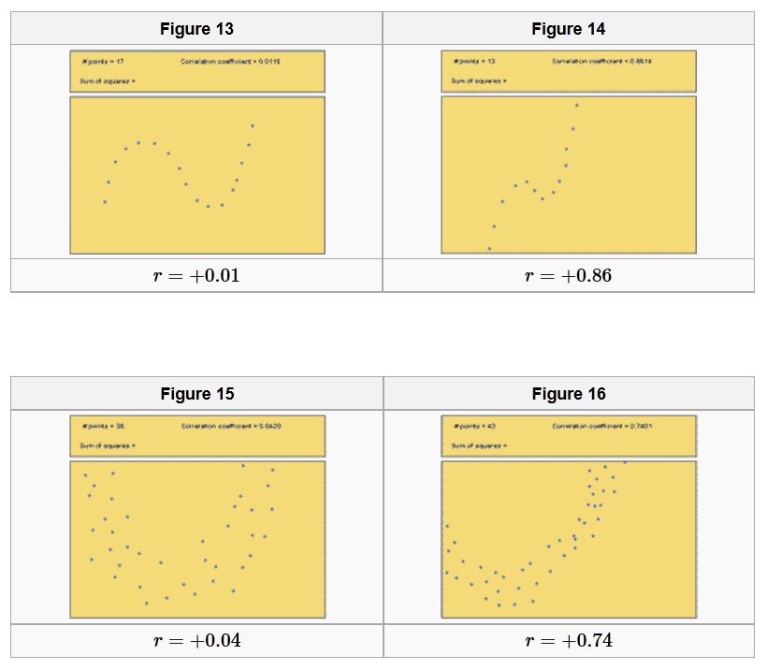
Non-Linear Relationships

